Slide 1



Slide 2
Braille Language Assistant
Team Members :
Amoli S. Vora
Kruti V Vaghela
Rachit Yagnik
Varun Shah
Mentor :
Prof. Dr. Vipul K. Dabhi
Department
Faculty of Technology, Information Technology.

Slide 3
Team
Name of Team Member | Capabilities
Amoli S. Vora | coding
Kruti V. Vaghela | circuitry
Rachit Yagnik | coding
Varun Shah | circuitry
Team Mentor: Prof. Vipul K. Dabhi

Slide 4
Brief Description
IOT based application.
Input(alphabet) is identified through Vibrators.
Components used are Arduino Uno, Bluetooth module HC-05, Vibrator motor, Buzzer.
Device is integrated with android application.

Slide 5
Value proposition
Teach visually impaired people.
Cost effective by using vibrators instead of currently used tactile plates.
Reduces the efforts of teacher for printing braille script.

Slide 6
Market Survey
Currently used device are Refreshable Braille display, Braille terminal, Tactile based braille box.
They mostly contain rods which are arranged in 3*2 matrix.
Rods are embossed on plate given an input.
Our device is more cost effective and built using vibrators.
Vibrators vibrates according to given letter as input.
Useful to NGOs and associations working for visually impaired people.

Slide 7
Current Stage & Next Stage

Slide 8
Current Stage
Alphabets are recognized successfully.
Using appropriate delay words are identified.
While giving sentence as input space are recognized by buzzer.
Device made with vibrators have replaced tactile based device.

Slide 9
Current Stage
Integrating Arduino, Bluetooth module HC-05, vibrators, android application and coding using Arduino IDE.
Language is converted and recognized in braille script.
Prototype working model of device is successfully constructed.

Slide 10
Next Stage
Just to make the device more compact and durable.
Variable delay time can chosen depending on letter learning capability.
Multiple languages can be implemented.
Voice recorder and Sd-Card reader can be integrated.
Bluetooth module can be replaced by WiFi module for better accessibility.

Slide 11
Next Stage
Next step would be to implement variable delay by modifying Android application coding.
Multiple languages can be implement by extending Arduino coding.

Slide 12
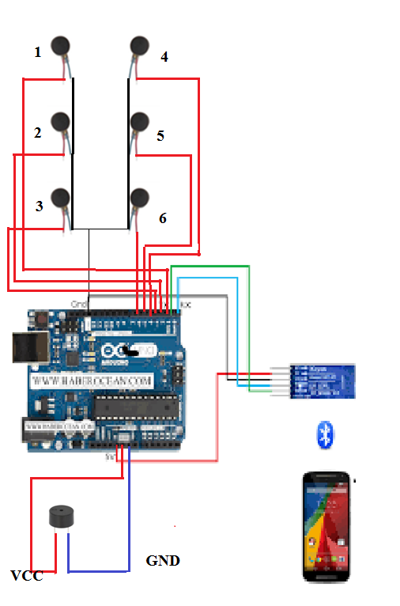
Proposed solution

Slide 13
Detailed Explanation of Proposed Solution
Input string is given through Android application.
Data is received on arduino via bluetooth module.
Corresponding to input vibrators and buzzer are activated.
If chosen for display previous data are displayed in android application.

Slide 14
Block Diagram of System/ Steps/ Process
Android Application
Arduino UNO
Braille Device
Bluetooth Module HC-05

Slide 15
Detailed Block Diagram
Power Supply Unit
Arduino
Braille Device
Bluetooth Module
HC-05
Android Application

Slide 16
Fund requirements
Total cost (including consumables, non consumables, recurring and non recurring):
RS.5000 (minimum)

Slide 17
Non Recurring/Non Consumables
Component Name | Where it will be used? | Quantity | Price per Unit (INR) | Total | Alternate components , its price and reason for not choosing the same
Arduino UNO | Circuit | 1 | 400 | 400 | Arduino MEGA(costly)
Bluetooth Module HC-05 | Circuit | 1 | 350 | 350 | Bluetooth Module HC-06 (It can only used as Slave device)
Vibrator motors | Circuit | 7 | 100 | 700 | Cylindrical vibrator (Vibrating capability is less)
Buzzer | Circuit | 1 | 30 | 30 | -
Arduino cable | Circuit | 1 | 50 | 50 | -
Power bank | Circuit | 1 | 500 | 500 | -
Total(A) |  |  |  | 2030

Slide 18
Recurring/Consumables
Item | Quantity | Price per Unit (INR)
Jumper wires | 25 | 50
Connecting wires | 2 | 80
Conducting tape | 1 | 30
General purpose board | 1 | 20
Total |  | 180

Slide 19
Miscellaneous Expenses
Head | Price(INR) | Reason
Travelling costs | 800 | Visit to Andhjan Mandal at Ahemdabad

Slide 20
Path forward
Device can be serially connected to built a complex system which can give words as output at a same time.

Slide 21
References
https://www.arduino.cc
https://www.itead.cc
http://appinventor.mit.edu

Slide 22
Thank You

